Slide 1
COVID-19 Analysis in EU/EEA Countries
DV1597 Assignment 2
Group 9
Grace Dona Harlita Tarihoran

Slide 2
Introduction
Analyzed COVID-19 cases, deaths, vaccination, and healthcare burden in EU/EEA countries.
Datasets obtained from ECDC.
Tools : Pandas, Numpy, Plotly, Matplotlib, Seaborn
Goal : identify patterns and healthcare impacts during the pandemic.

Slide 3
Datasets Used
Cases and deaths dataset
Vaccination dataset
Hospital and ICU dataset
Period: 2020–2023

Slide 4
Data Preprocessing
Handled missing and negative values.
Created year, quarter, and week variables.
Calculated population-normalized rates.
Created grouped summary tables.

Slide 5
Handled missing and negative values
Dataset | Finding in Column | Action
Cases and Deaths | Negative values in cases and deaths column cases contains 93 (0.3%) missing values deaths contains 292 (1%) missing values | Convert negative values to NaN Convert dates and sort chronologically Country-Level Grouping Apply Grouped Linear Interpolation
Vaccination | Denominator contains 319,779 (46.9%) missing values NumberDosesReceived contains 595,499 (87.4%) missing values NumberDosesExported contains 590,036 (86.8%) missing values FirstDoseRefused contains 679,883 (99,78%) missing values | Keep Denominator as NaN Impute missing values with 0 for: NumberDosesReceived, NumberDosesExported, and FirstDoseRefused column
Hospital and ICU | url contain 25,100 (100%) missing values | Remove the column url

Slide 6
Why are there negative values in Cases and Deaths Dataset?
Overcounting Corrections after review their historical records.
double-counted cases
misclassified non-COVID deaths as COVID deaths during previous weeks
simply apply a negative number to the current day to adjust the running cumulative total.
For example, looking into the dataset, France reported -348,846 cases on May 20, 2021. This was a massive historical data correction made by the French government to clean up duplicated patient files from earlier months.

Slide 7
What is Denominator in Vaccination Dataset?
The Denominator represents the size of the specific target group within that country (e.g., the number of healthcare workers or the population of the Age70_79).
Denominator contains 319,779 (46.9%) missing values
We use population instead of denominator in later analysis

Slide 8
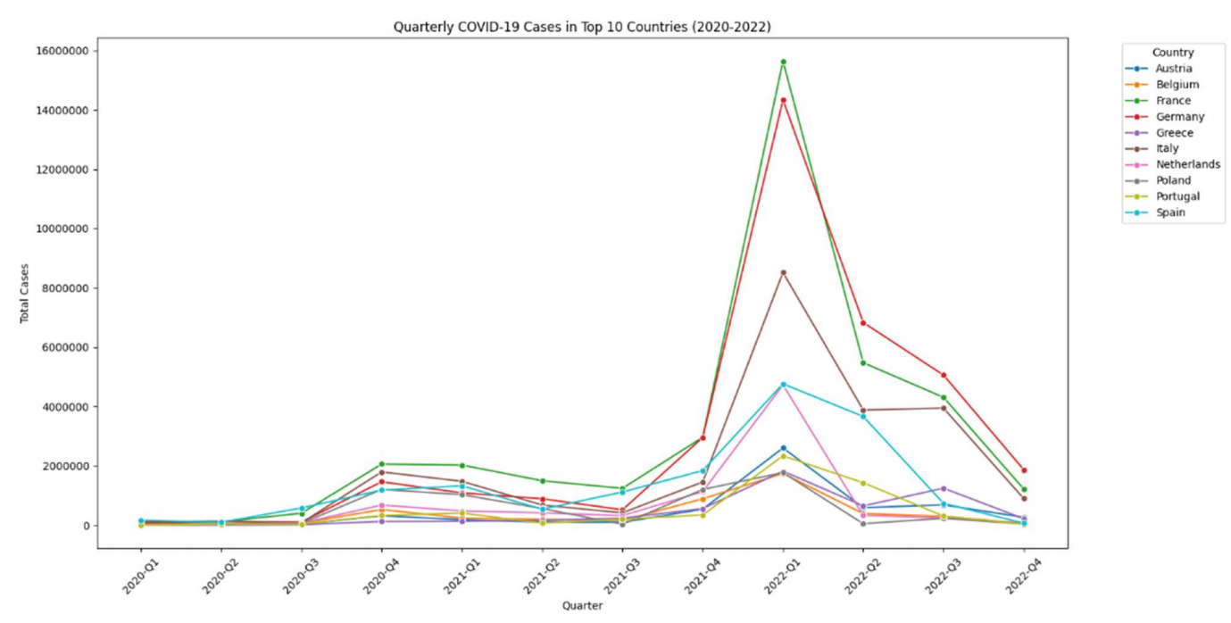
Cases and Deaths Data: COVID-19 Cases and Death Analysis Q1.1: Top countries with the highest cases by quarter

Slide 9
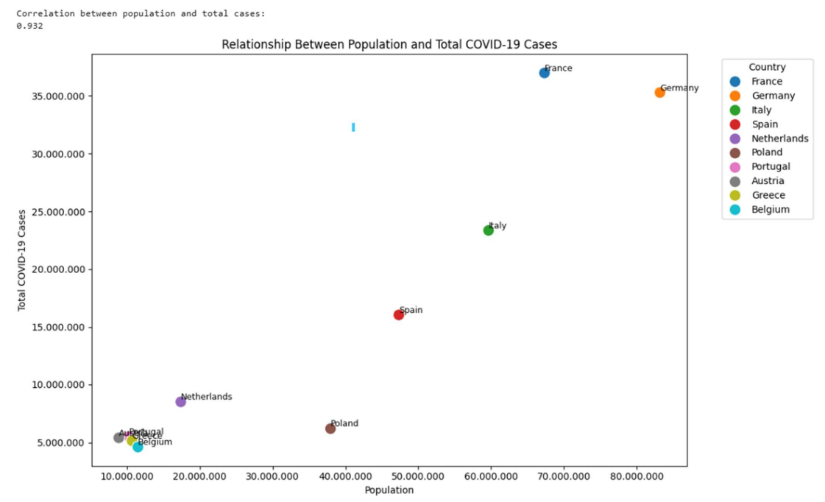
Cases and Deaths Data: COVID-19 Cases and Death Analysis Q1.2: The relation between the high number of cases and the country’s population

Slide 10
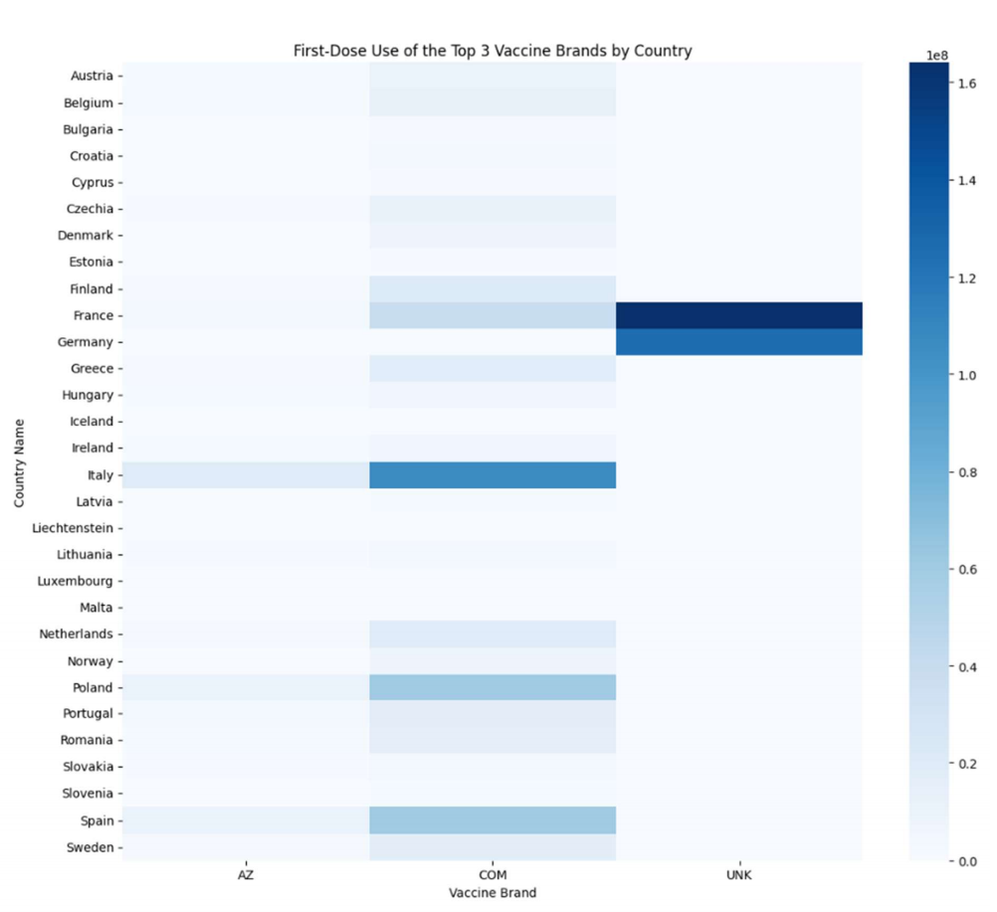
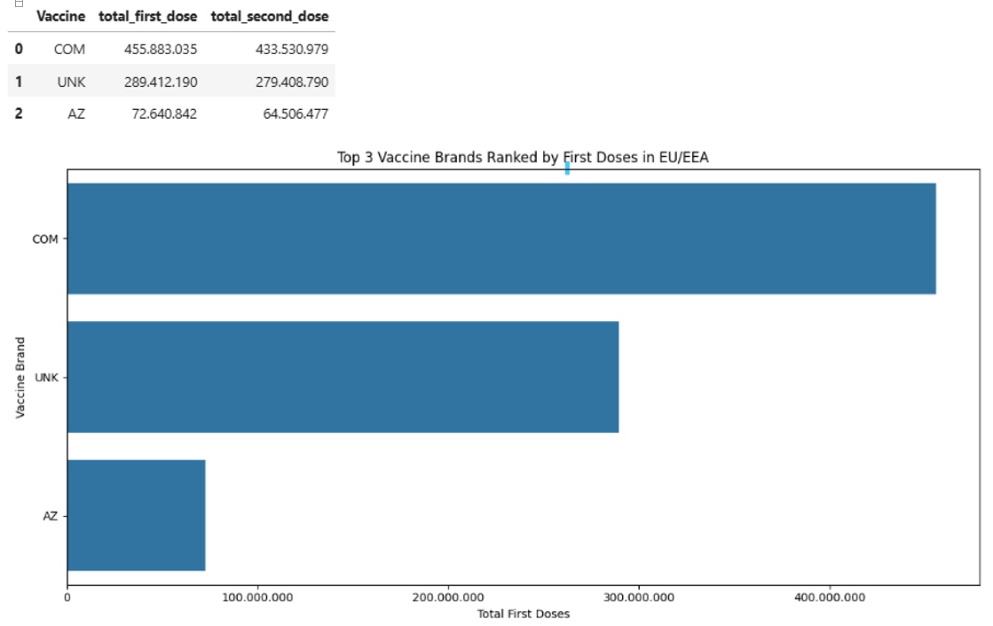
Vaccination Data: Vaccination Brand and Distribution Analysis Q3: The top 3 popular vaccine brands used across the EU/EEA and at the country level.
Code | Vaccine Brand
COM | Comirnaty/ Pfizer-BioNTech
MOD | Moderna/ Spikevax
AZ | AstraZeneca/ Vaxzevria
JANSS | Janssen
NVXD | Novavax
UNK | Unknown vaccine brand

Slide 11
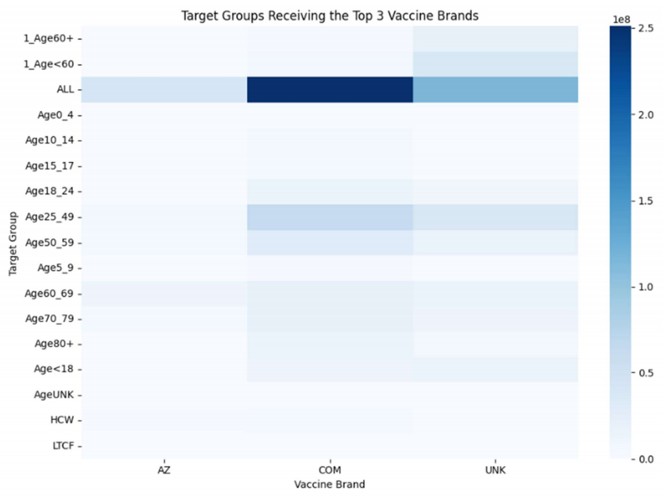
Vaccination Data: Vaccination Brand and Distribution Analysis Q4: Target groups received the popular vaccine brands in each country

Slide 12
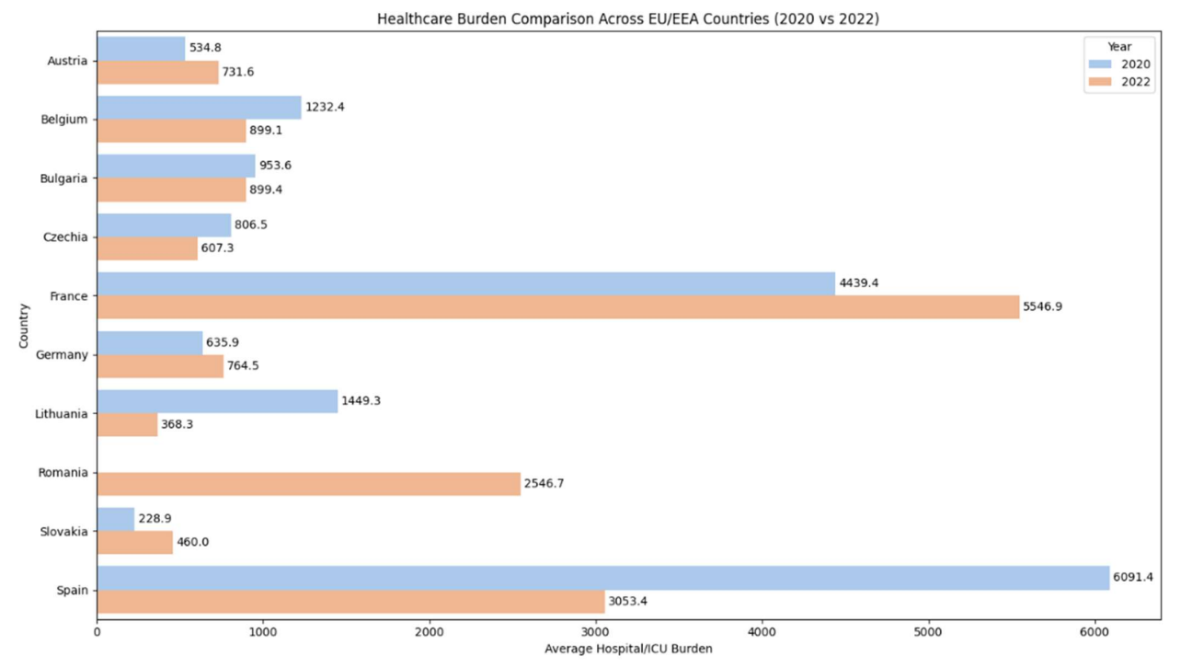
Hospital and ICU Data: Healthcare System Impact Q8: The most affected countries’ health care by the coronavirus pandemic in 2020.

Slide 13
Additional Research Questions
Did higher first-dose vaccination rates relate to lower death rates?
Did higher booster uptake reduce ICU pressure?
Did higher case rates increase healthcare burden?

Slide 14
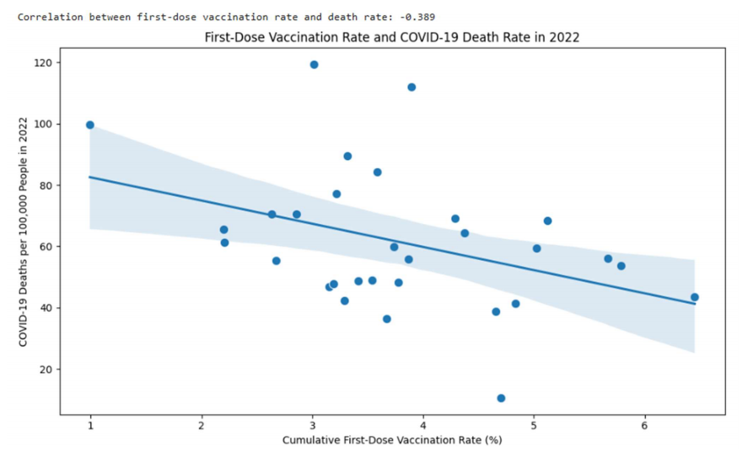
Pearson correlation: -0.389 Weak-to-moderate negative relationship Higher first-dose vaccination rates were associated with lower death rates.

Slide 15
Key Finding 2
Additional-dose uptake did not show a strong relationship with ICU pressure.
Some countries with high booster uptake still had high ICU burden.
Healthcare burden was influenced by multiple factors.

Slide 16
Key Finding 3
High COVID-19 case rates were only weakly associated with ICU pressure.
Pearson correlation: 0.200
Healthcare burden depended on more than infection rates alone.

Slide 17
Discussion
COVID-19 outcomes were influenced by vaccination, healthcare capacity, demographics, and virus variants.
Vaccination likely reduced severe outcomes.
Country-level differences remained significant.

Slide 18
Conclusion
COVID-19 impacts across EU/EEA countries were complex and multifactorial.
Vaccination programs likely helped reduce mortality and severe disease.
Data analysis provided useful public health insights.

Slide 19
Q & A

